Slide 1
CSCI-331: Project 3
New Group 2:
Faisal Areefin, Kathy He, Jude Pierre, Jianhao Jin, Matthew Robles, Jamal Siddiqui, Osvaldo Talavera

Slide 2
Contents
Project Planning and Tracking
Project Lifecycle
Database Design
Stored Procedures
Testing
JDBC Execution

Slide 3
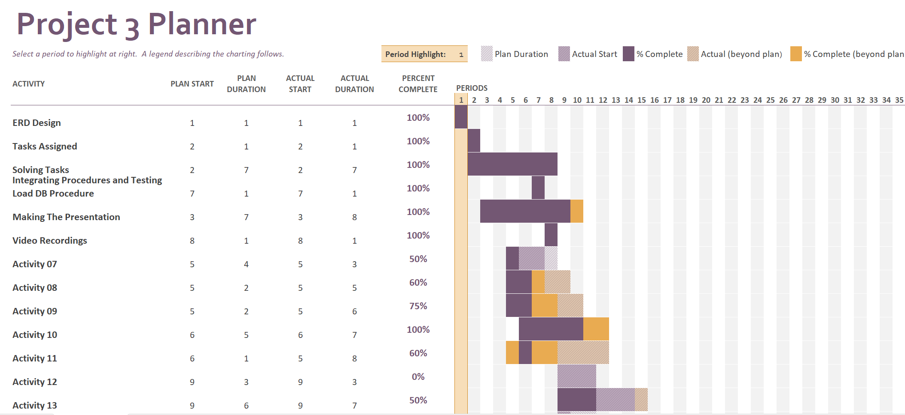
Project Planner

Slide 4
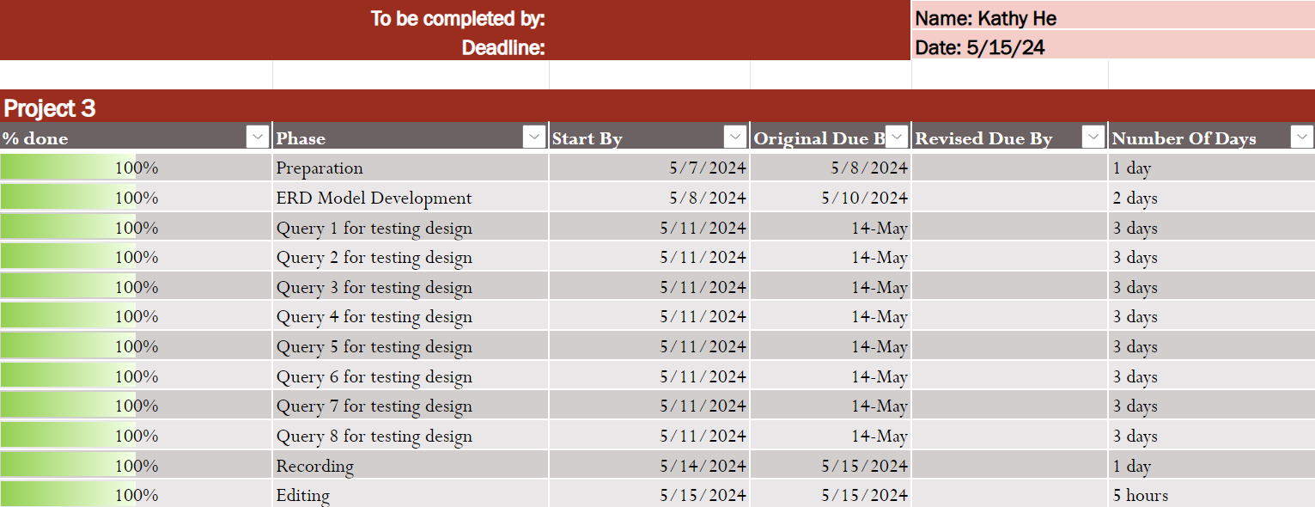
Kathy He To-do/NACE

Slide 5
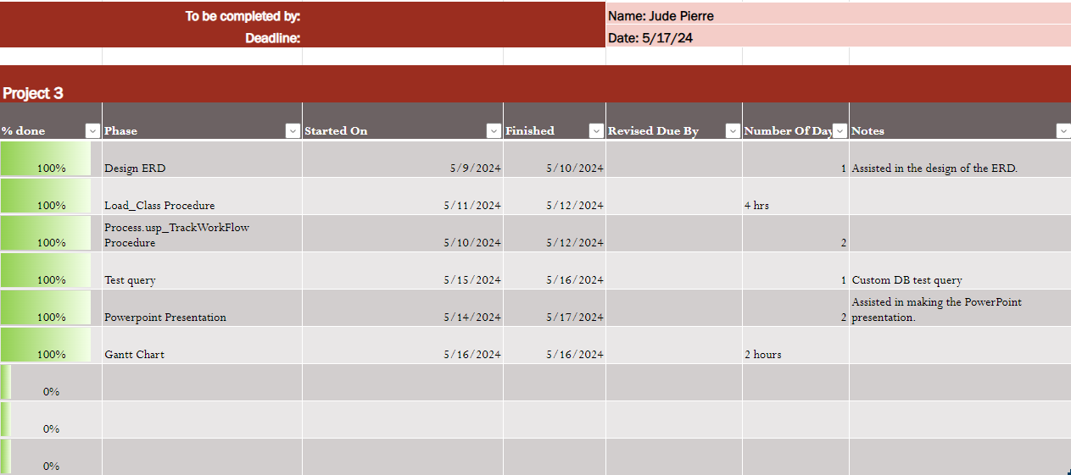
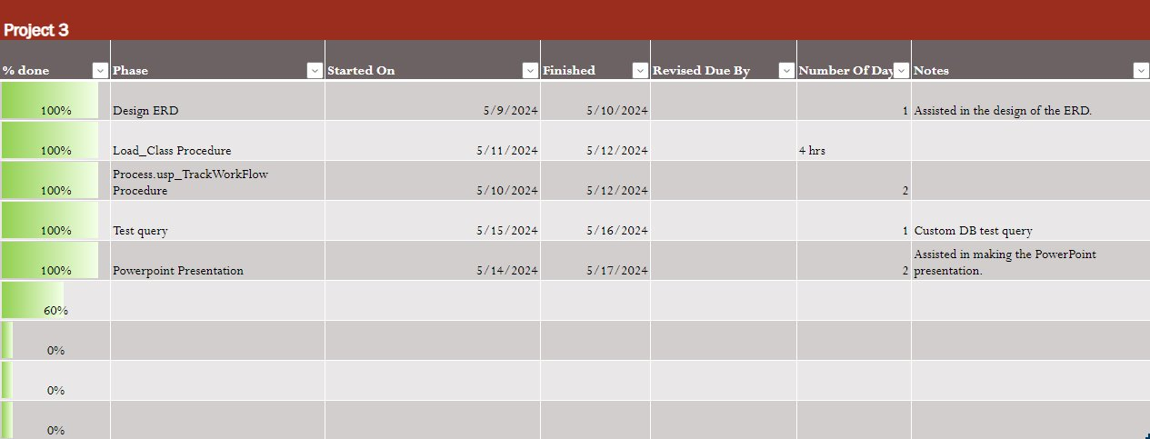
Jude Pierre To-do/NACE

Slide 6
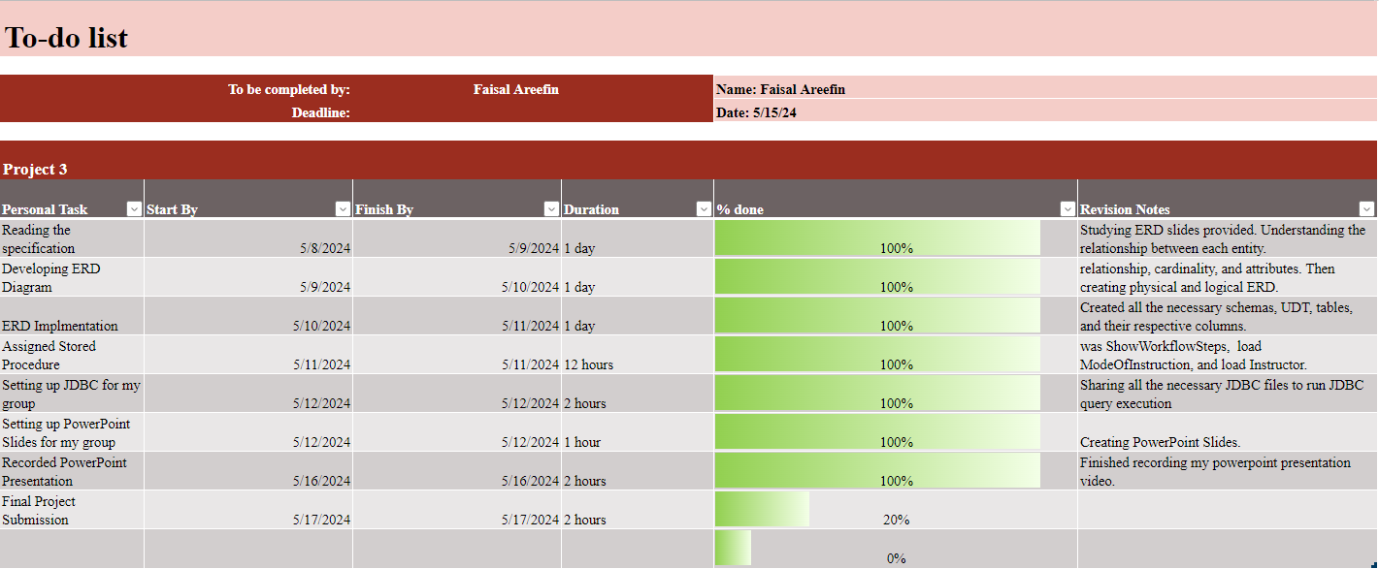
Faisal Areefin To-do/NACE: Teamwork
Maintained accountability for individual and team tasks and deliverables.
Collaborated with others during the database design process.
Utilized personal abilities and knowledge to complement those of others.

Slide 7
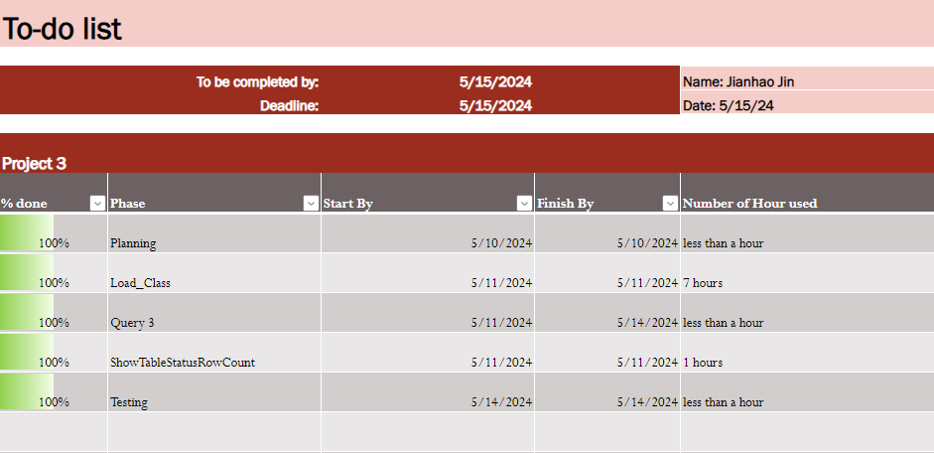
Jianhao Jin To-do/NACE

Slide 8
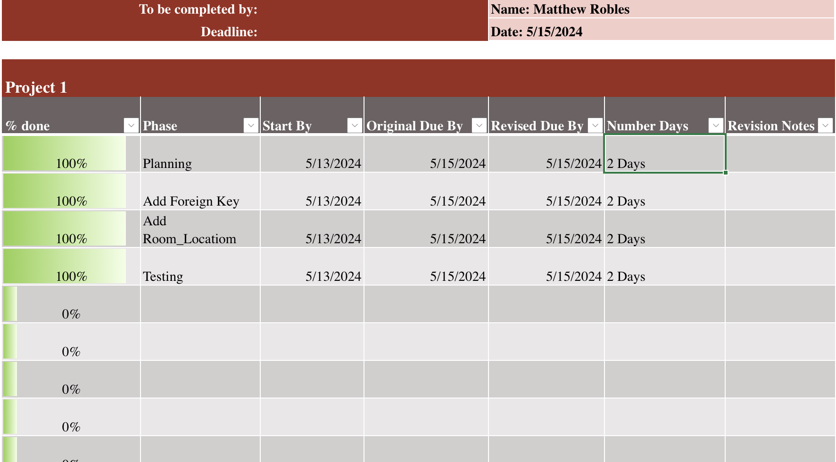
Matthew Robles To-do/NACE

Slide 9
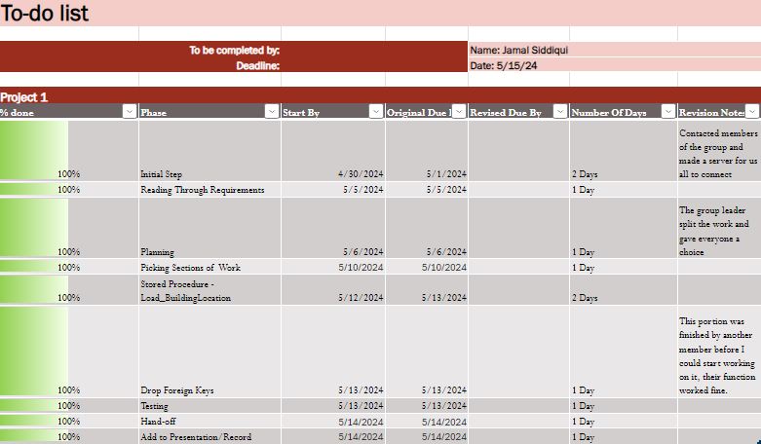
Jamal Siddiqui To-do/NACE

Slide 10
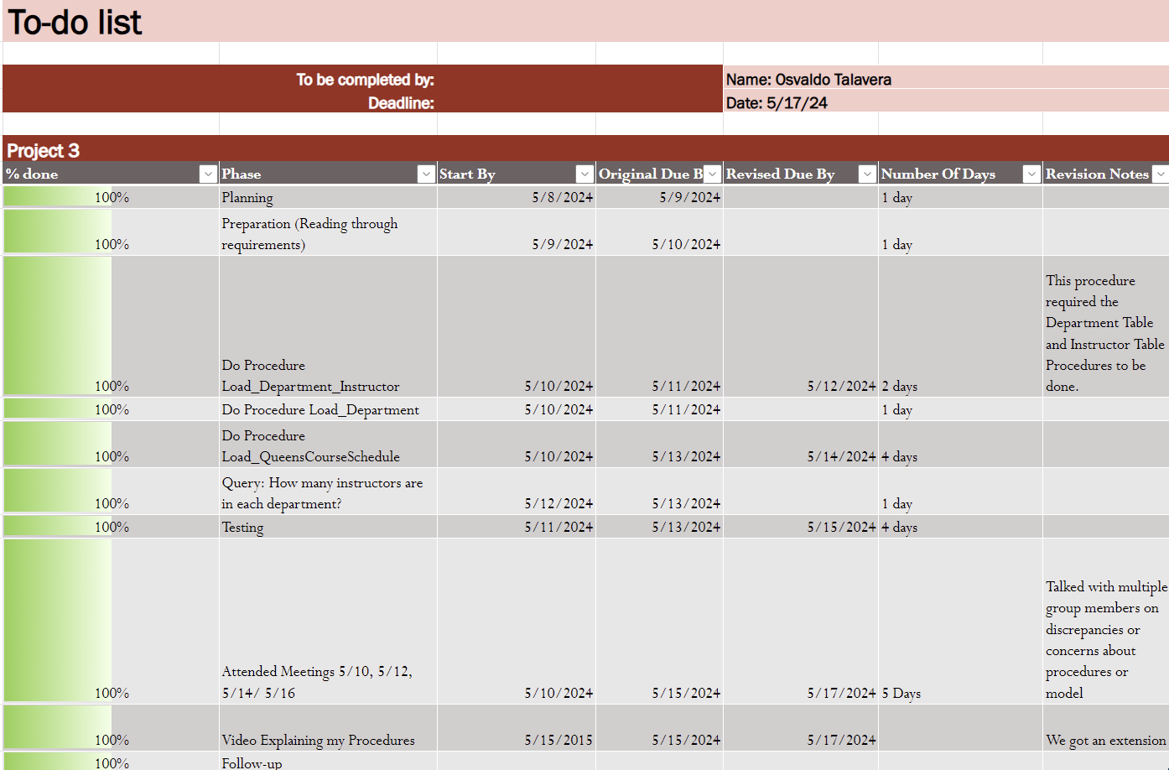
Osvaldo Talavera To-do/NACE

Slide 11
Meeting Notes
*These meetings were conducted fully virtually using the social media network Discord*
*an associate developer in the context of this project is someone who worked on the project within the database side*
We assigned roles first:
Associate Developer/Leader: Faisal Areefin
Associate Developer/Backup Leader: Kathy He
Associate Developer/Note Taker: Jamal Siddiqui
Associate Developer/Procedure Management: Jianhao Jin
Associate Developer/Procedure Management: Osvaldo Talavera
Associate Developer/PowerPoint Slides: Jude Pierre
Associate Developer/Virtual Support: Matthew Robles

Slide 12
5/10/24
Attended By: All
Absences: None
Agenda: To look through the project, start some aspects, discuss submission details.
Meeting Description: Faisal initiated the discussion by outlining the progress on the ERD diagram and the setup of necessary tables and columns. He shared the database backup file and announced that he would distribute the database so that each member could replace their existing backup with the updated version. He also shared a link to the ERD diagram for further reference. The group then discussed how we would handle the final submission. Initially Osvaldo suggested Google Drive, but we all agreed upon Kathy's suggestion to use Dropbox. We discussed the need to assign everyone specific parts to do, Jude created an Excel spreadsheet so everyone can choose what elements of the project they would work on. We wrapped the meeting up with a reminder to stay aware of the initial due date.

Slide 13
5/12/24
Attended By: All
Absences: None
Agenda: Discuss the assignment of tasks to each member, address the JDBC, set deadlines and goals.
The group looked at the spreadsheet Jude made and confirmed that every task of the project was accounted for. When we confirmed that all the operational procedures, table procedures, and testing queries had someone responsible for them, we moved on to their execution. Faisal brought up the JDBC and shared the JDBC that he was working on for a few days. He tested it for the group, and we all agreed to use it. He proposed that Kathy could collect everyone’s contributions. He also provided links to the shared To-do list and the initial draft of the PowerPoint slides. We ended the meeting with a focus on getting the work done over the next few days.

Slide 14
5/14/24
Attended By: All
Absences: None
Agenda: Evaluating the progress of the project's technical components, start discussing project management strategies, plan the compilation of the final submission
This meeting was to discuss our progress on the project's technical elements. Specifically involving the database, stored procedures, and testing queries. Over the past few days, group members sent their work to our collective group workspace so that we could collaborate and test each other's work. Faisal updated the group that he had successfully integrated almost all the necessary stored procedures into the database, with only a couple left, which were addressed and worked on by Jamal and Matthew by the end of the day. It seemed that everyone was on track and making progress with the technical side of things. We slightly discussed the project management side, reminding each other to start working on To-Do lists and maintain a general timeline. The meeting adjourned with us discussing the compilation of the final submission.

Slide 15
5/16/24
Attended By: All
Absences: None
Agenda: A final review of all project aspects
This meeting effectively served as a final check to ensure that all aspects of the project were accounted for in their presentation. The team discussed the importance of accurately representing the data and the steps they had taken throughout the project, ensuring that the presentation would be comprehensive and well-prepared for submission. We ended this meeting to compile all work and documents, finish up the slides, record everything, and get ready to submit everything. It was mostly focused on the project-management side of things rather than the technical side, to deliver a final product.

Slide 16
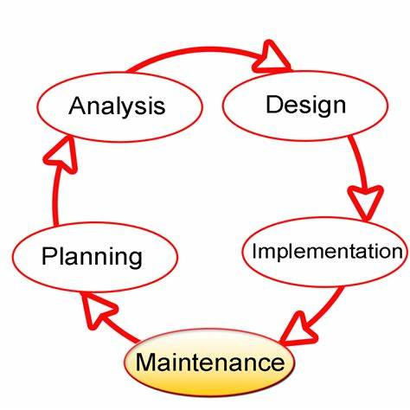
Project Lifecycle
Planning
Analysis
Design
Implementation
Maintenance

Slide 17
Planning
Assigned roles to each group member.
Distributed and tracked tasks using the To-do List provided, allowing for a streamlined process.
Tracked the project over its lifecycle using the Gantt chart.
Documented discussions from the meetings that were held using Microsoft Word.

Slide 18
Analysis
Analyzed the project 3 instructions document in detail to understand the project.
Created sketches of each table and discussed column data, constraints, and relationships.
Utilized knowledge gained from the class to created bridge tables to handle M:N relationships,
and implemented 3NF normalization for each table.

Slide 19
Design
Utilized surrogate keys for primary and foreign key relationships.
Implemented tables with UDTs as the attribute types which assisted in data integrity, reusability, readability, and abstraction.
Created and utilized an ER diagram for the construction of the database.

Slide 20
Implementation
Created the database tables based on the ER diagram.
Tested all load procedures.
Revised table design (Department table originally had InstructorKey FK relationship).
Tested the Database with queries to simulate retrieval.

Slide 21
Maintenance
Did a top-down review of the database for errors and added check and default constraints for table attributes.
Addressed data anomalies such as empty rows for courses (two main culprits being internships and honors research courses) that do not have room locations or a fixed schedule.
Solutions involved constraints and creating conditions in the load procedures.

Slide 22

Database Design

Slide 23
Tackling Data Anomalies
In the original UploadFile.CurrentSemesterCourseOfferings file, these anomalies were present in these columns:
Day Column
(Blanks)
Time Column
'-'
Instructor Column
','
Location Column
(Blanks)

Slide 24
Strategies for Data Anomalies
First Pass
Day: TBD
Time: TBD
Instructor: Ignore
RoomLocation: Ignore
Second Pass
Day: N/A (Default)
Time: N/A (Default)
Instructor: N/A (Default)
RoomLocation: N/A (Default)

Slide 25
Original from UploadFile.CurrentSemesterCourseOfferings
Compared to Corresponding Rows in Course.Class

Slide 26
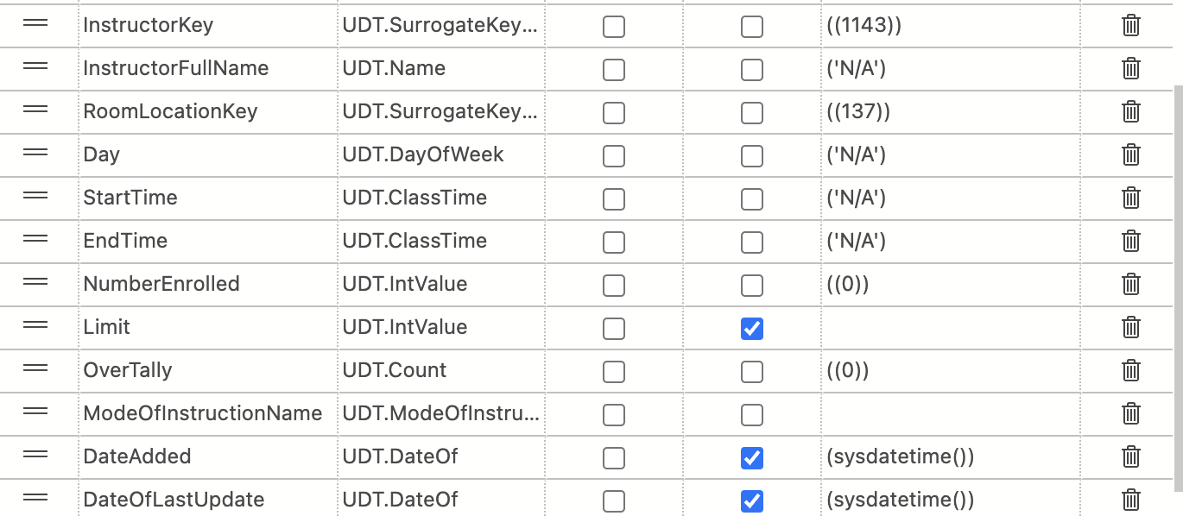
Default Constraints in Course.Class Table

Slide 27
Check Constraints
CHK_Class_Limit:
Limit>=0
CHK_Class_OverTally:
OverTally>=0
CHK_Class_NumberEnrolled:
NumberEnrolled>=0
CHK_Course_NumberOfHours:
NumberOfHours>=0
CHK_Course_NumberOfCredits:
NumberOfCredits>=0

Slide 28
Unique Columns
Department.DepartmentName
Instructor.InstructorFullName
BuildingLocation.BuildingLocationName
RoomLocation.RoomLocationFullName
Course.CourseName
ModeOfInstruction.ModeOfInstructionName

Slide 29
Derived Columns
Department.Instructor Table
InstructorFirstName
InstructorLastName
Location.RoomLocation Table
BuildingLocationName
RoomLocationNumber
Decision: Based off how data is represented in the Uploadfile.CurrentSemesterCourseOfferings table.

Slide 30
Naming Conventions
Schema names, table names, and column names were based on their relationship to the data that will be stored inside them.
An example Course and Class tables were both given the Schema name "Course" because the Course table is the parent to the Class table with 1:M relationship, while a class is an instance or 1 element of a course.
The Course table included columns such as CourseKey, CourseName, CourseDescription...which data for each course obtained from the data table will be stored.

Slide 31
DB UDT Metadata Taxonomy
UDT names were given based on their purposes, which assisted in self-documentation.
This way implementing UDTs in columns were easier and faster for table creation, writing procedures, and querying.
The UDT CourseName was reused in two tables and stored the name of the course.
The UDT UDT.SurrogateKeyInt was the most reused UDT in the database, as it was used for the PK columns of the tables.

Slide 32
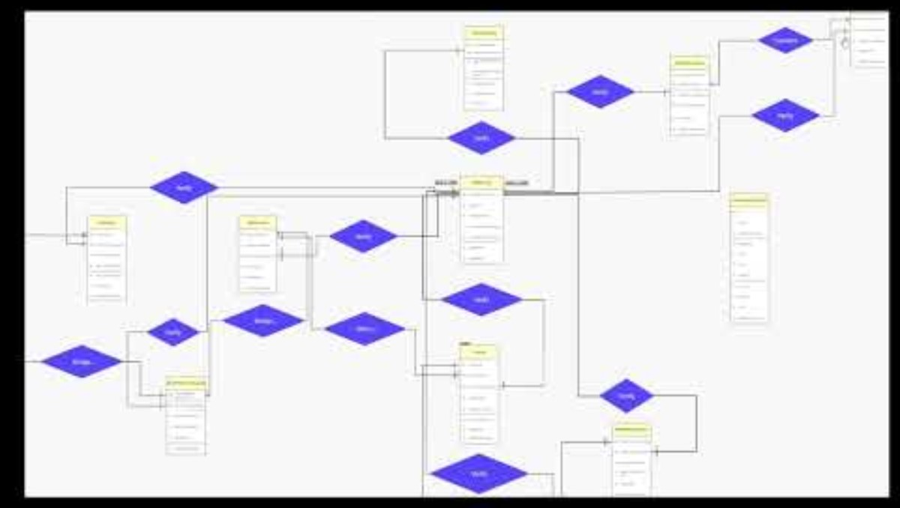
ER Diagram

Slide 33
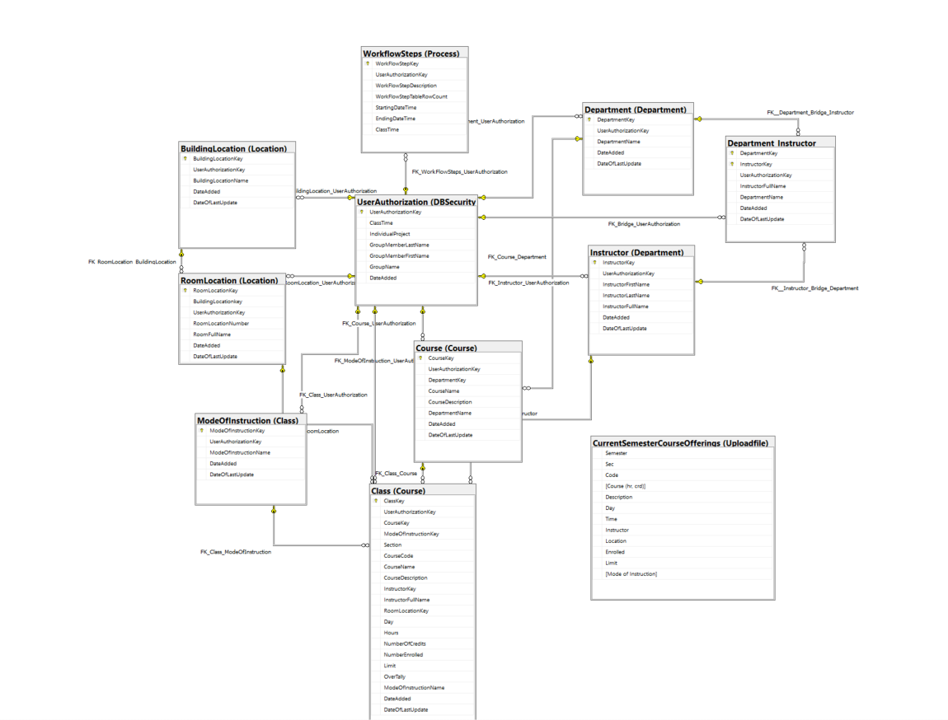
Logical Data Model Diagram

Slide 34
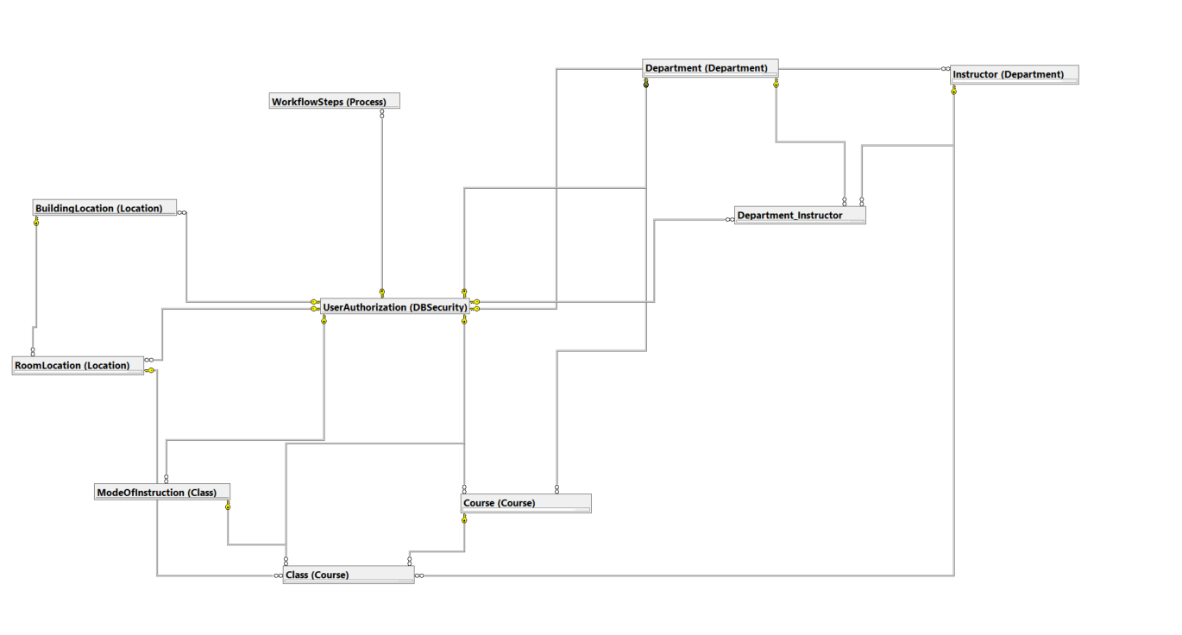
Conceptual Data Model Diagram

Slide 35
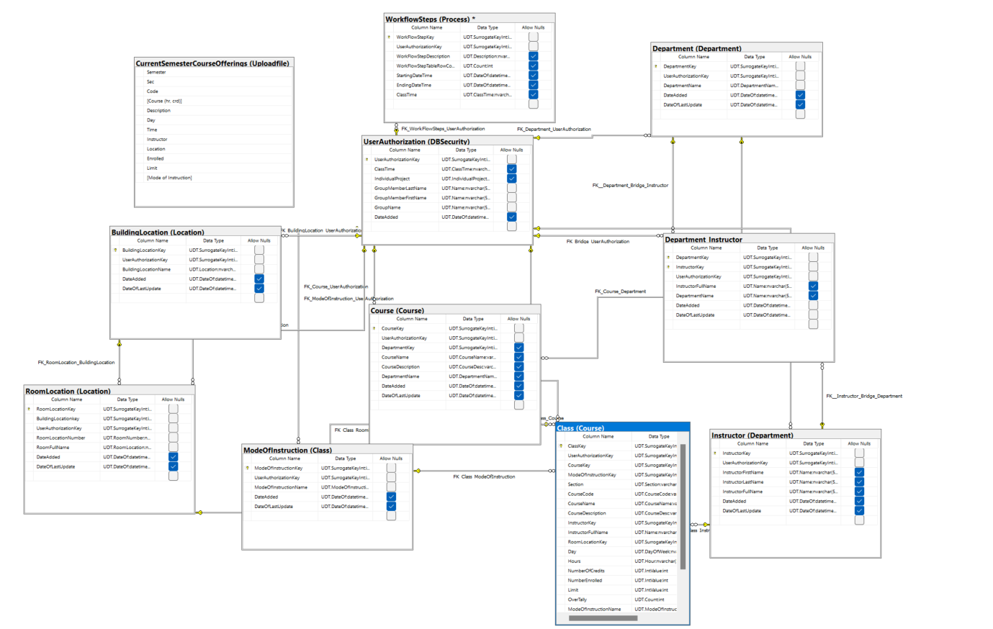
Physical Data Model Diagram

Slide 36
Database Stored Procedures

Slide 37
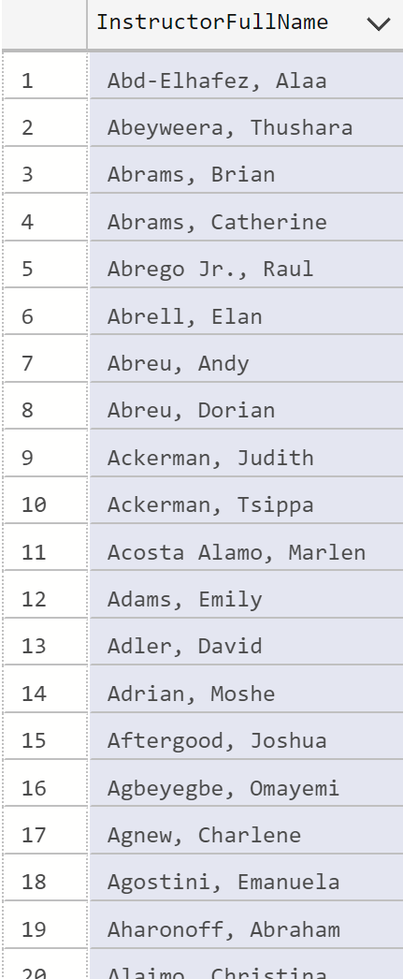
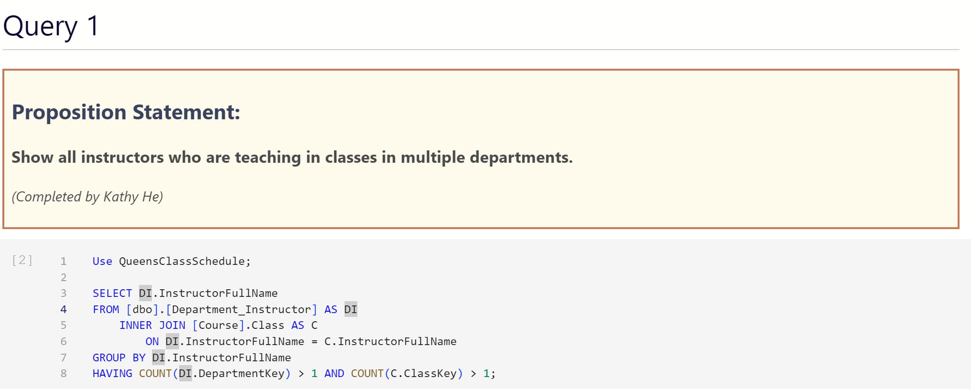
Kathy's Query #1

Slide 38
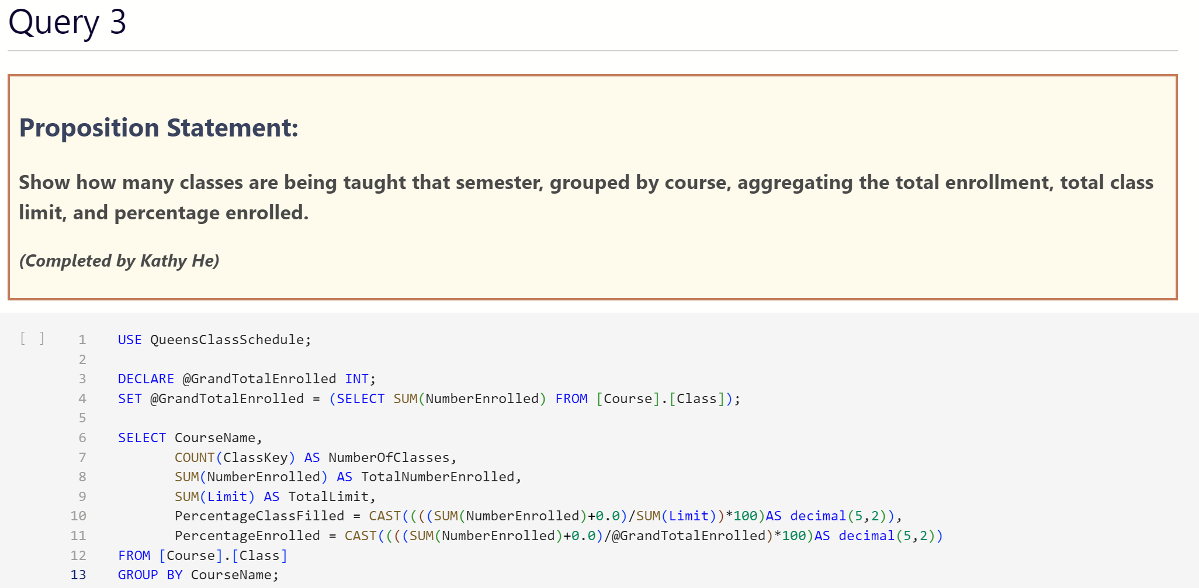
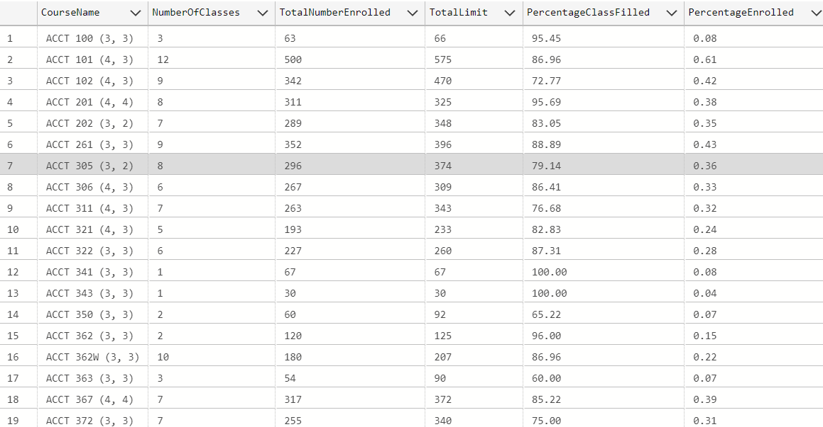
Kathy's Query #2

Slide 39
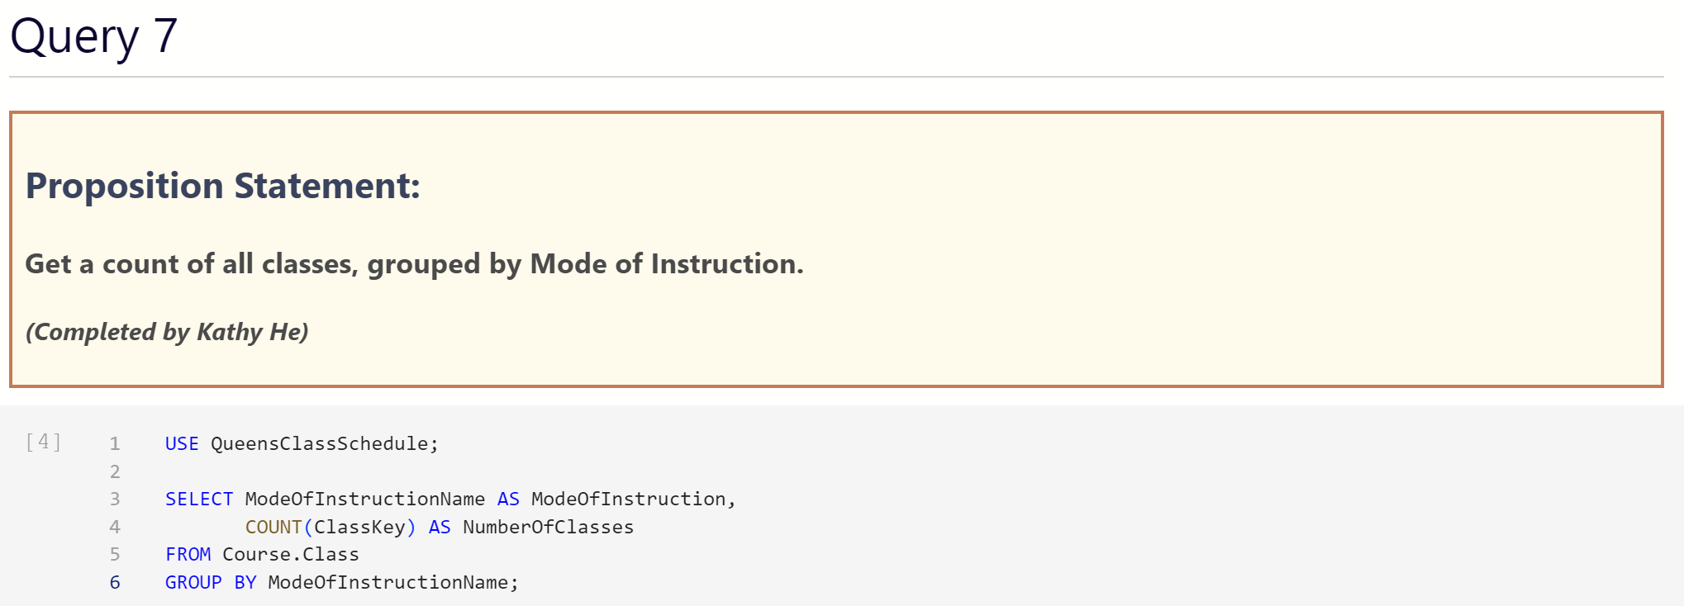
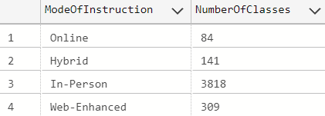
Kathy's Query #3

Slide 40
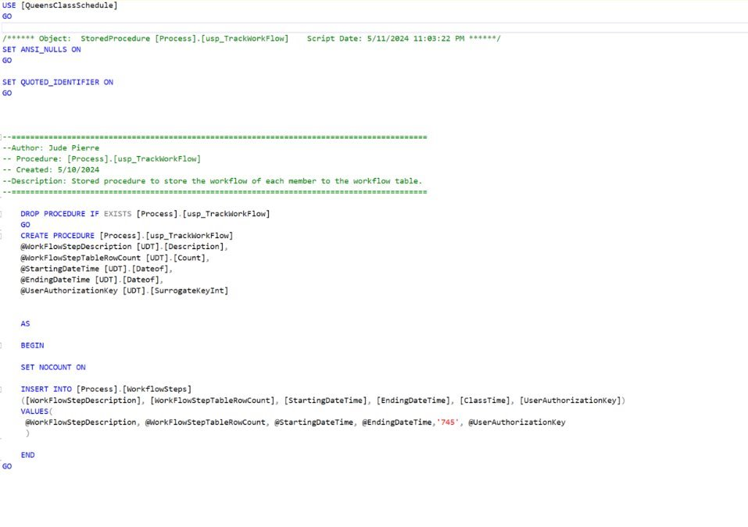
Jude's Stored Procedure #1

Slide 41
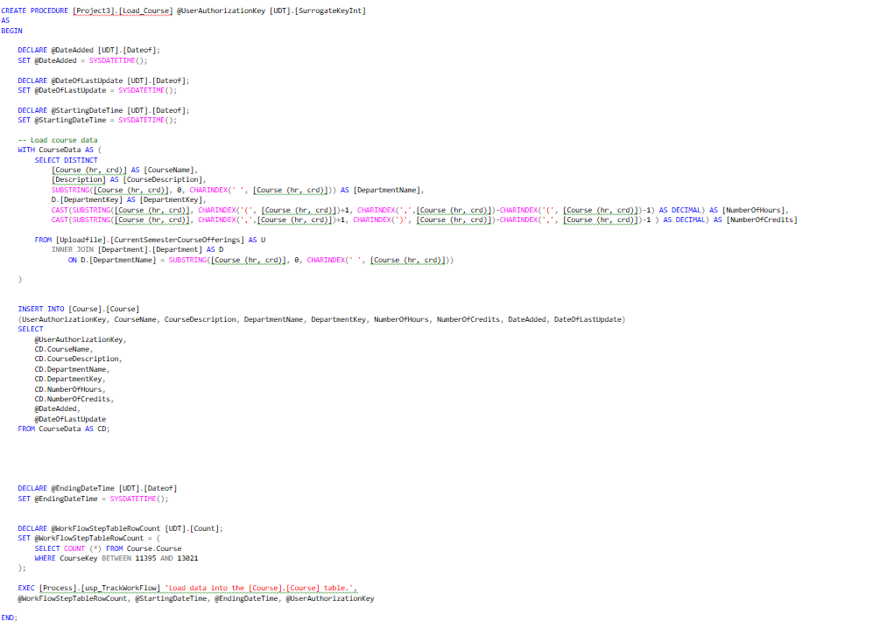
Jude's Stored Procedure #2

Slide 42
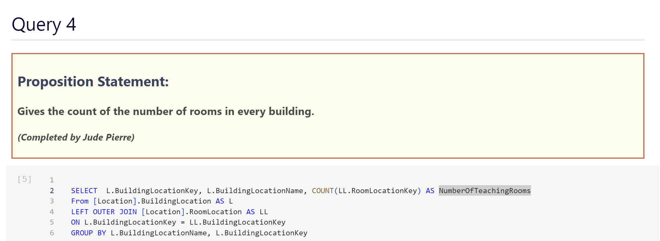
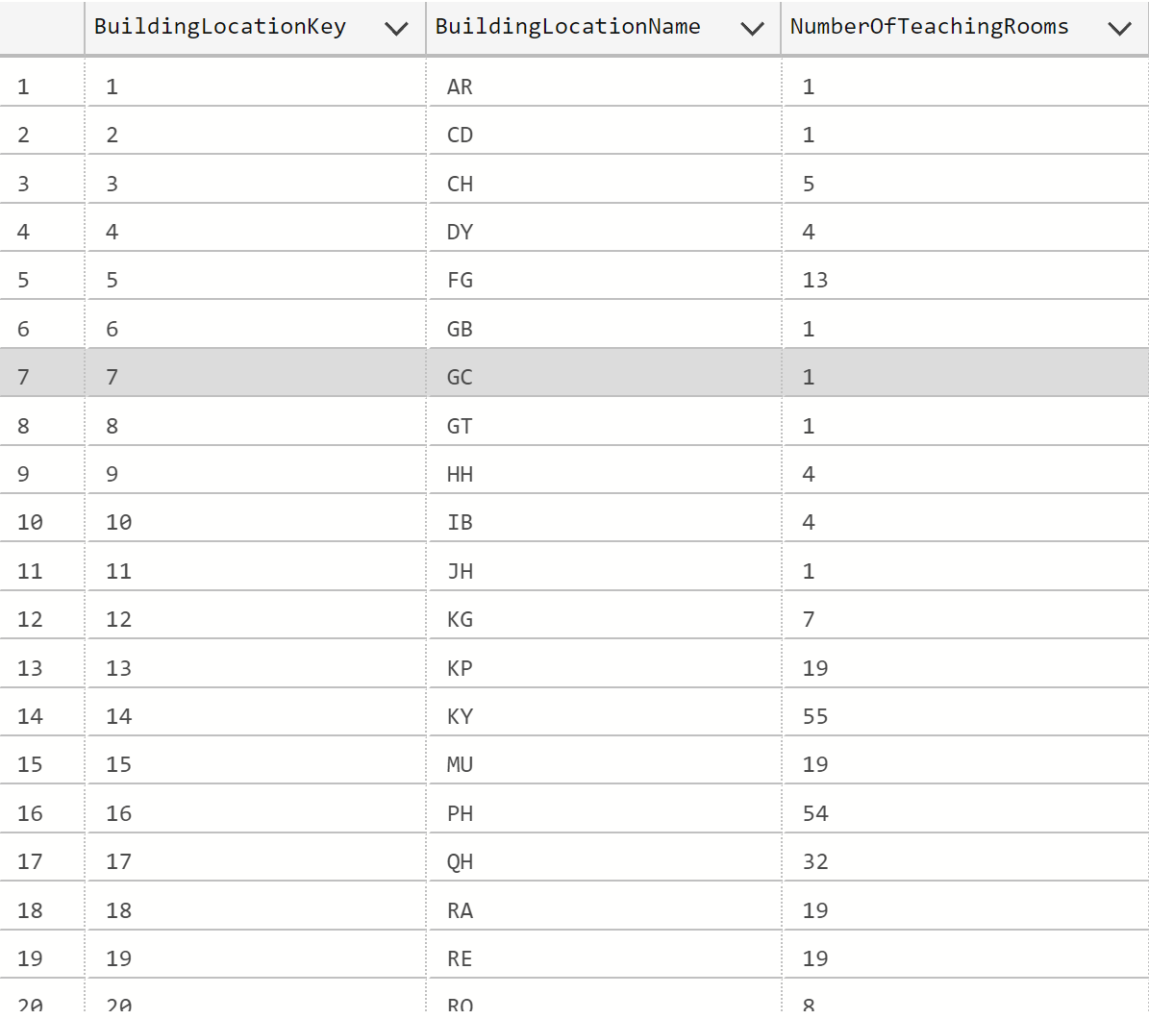
Jude's Query

Slide 43
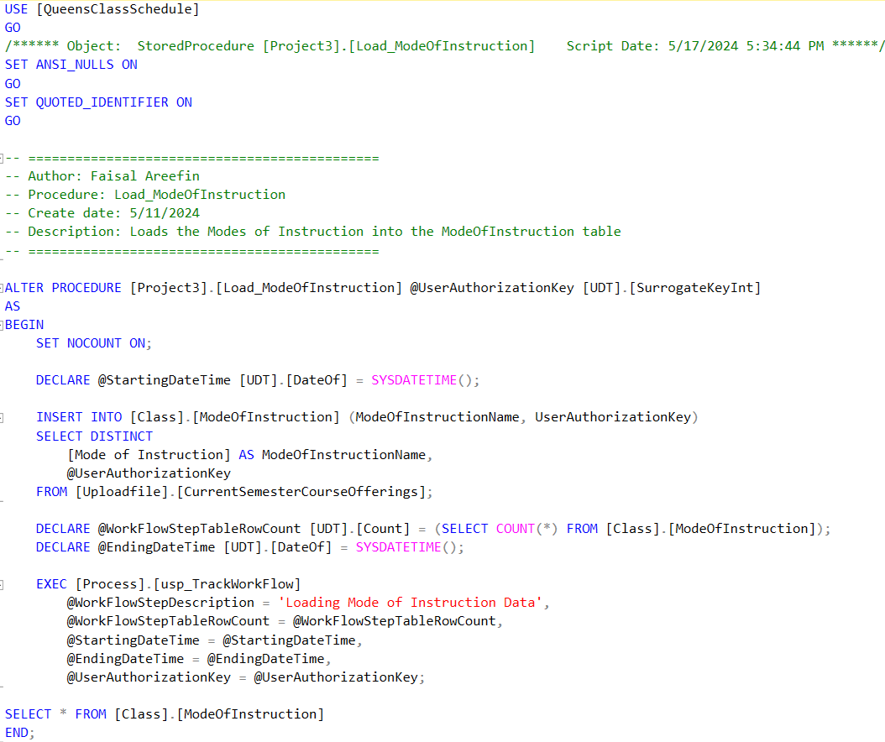
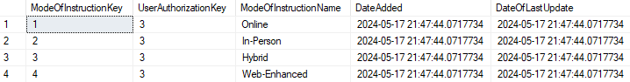
Areefin's Stored Procedure #1: ModeOfInstruction

Slide 44
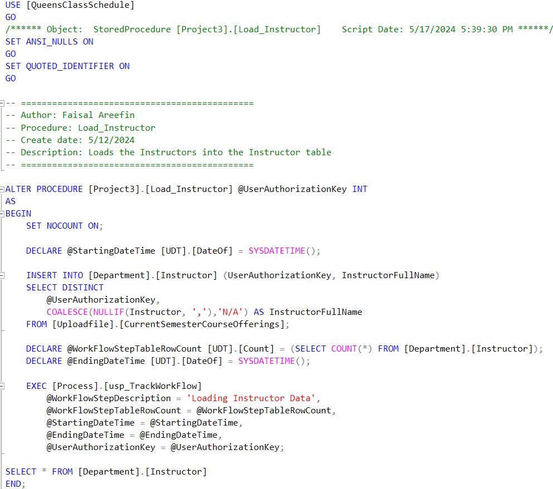
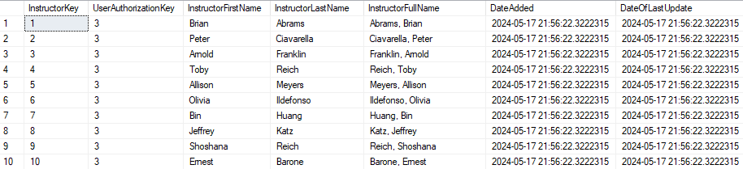
Areefin's Stored Procedure #2: Instructor

Slide 45
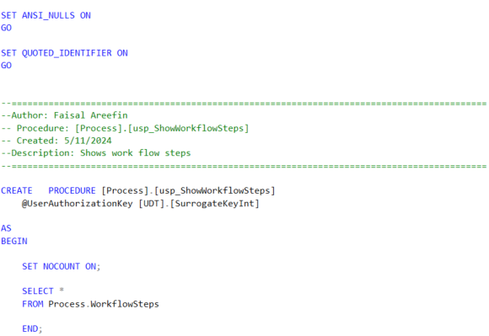
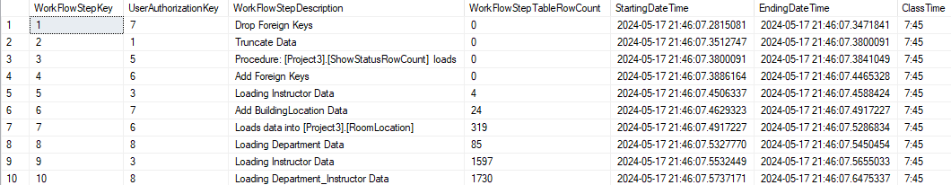
Areefin's Stored Procedure #3: ShowWorkFlowSteps

Slide 46
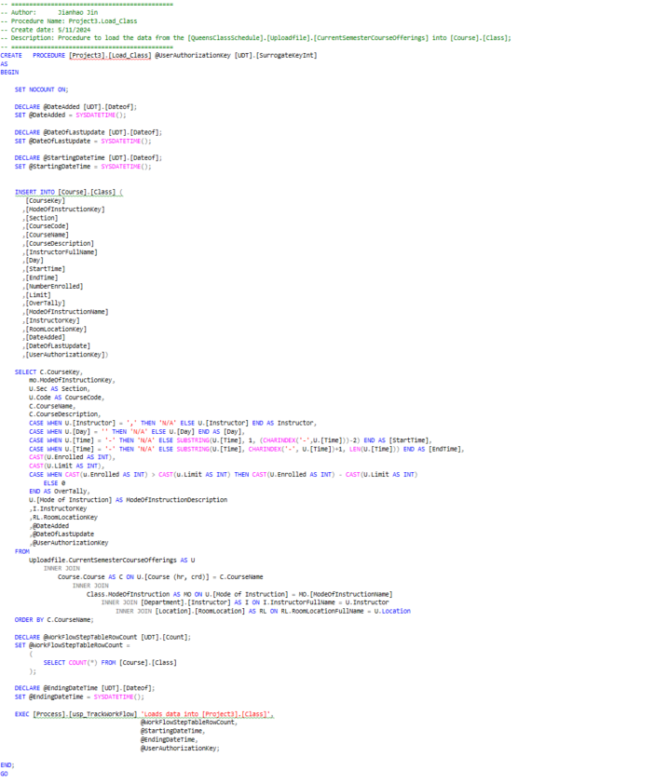
Jianhao's Stored Procedure #1

Slide 47
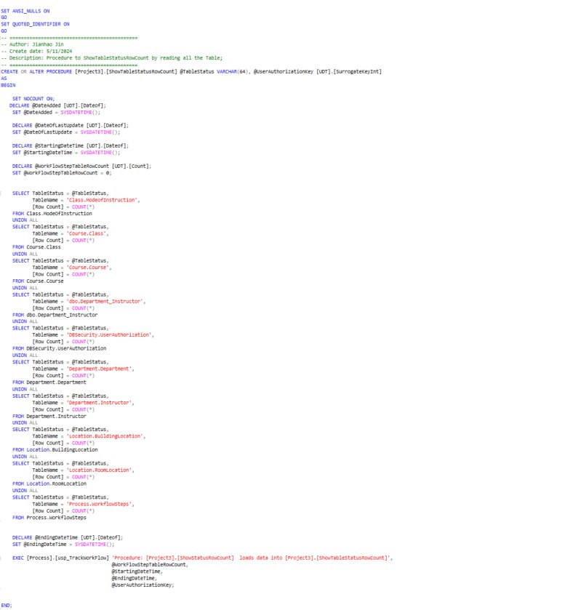
Jianhao's Stored Procedure #2

Slide 48
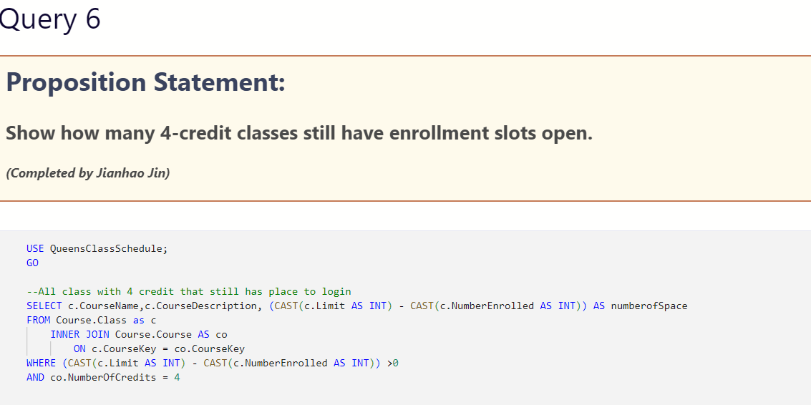
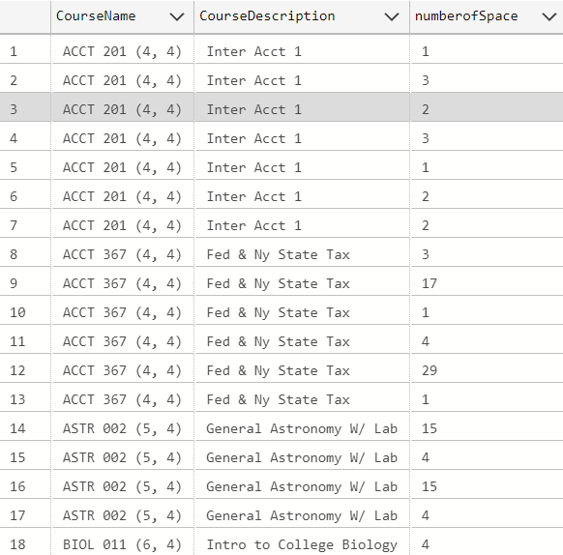
Jianhao's Query

Slide 49
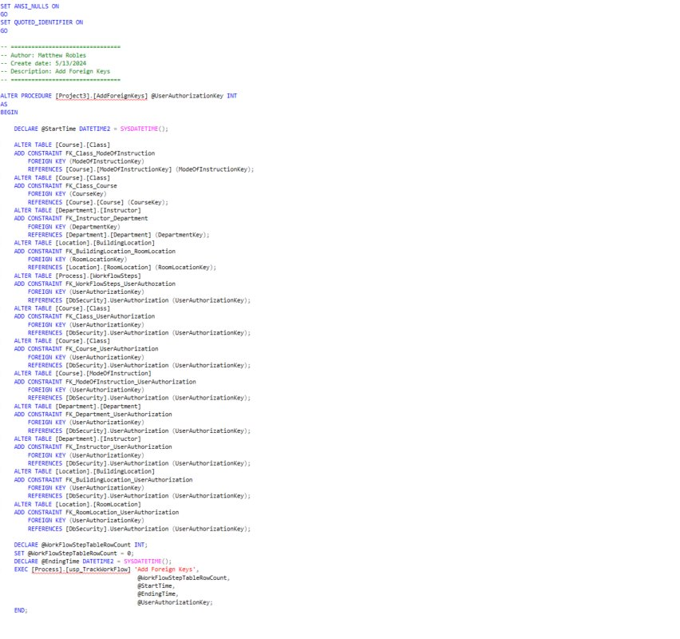
Matthew's Stored Procedure #1

Slide 50
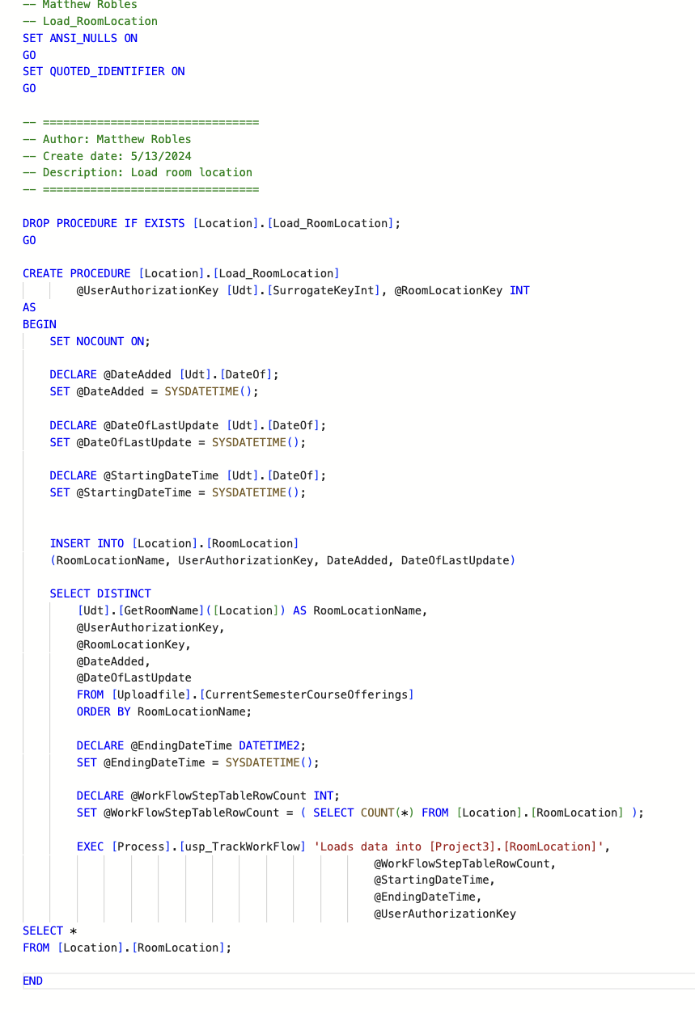
Matthew's Stored Procedure #2

Slide 51
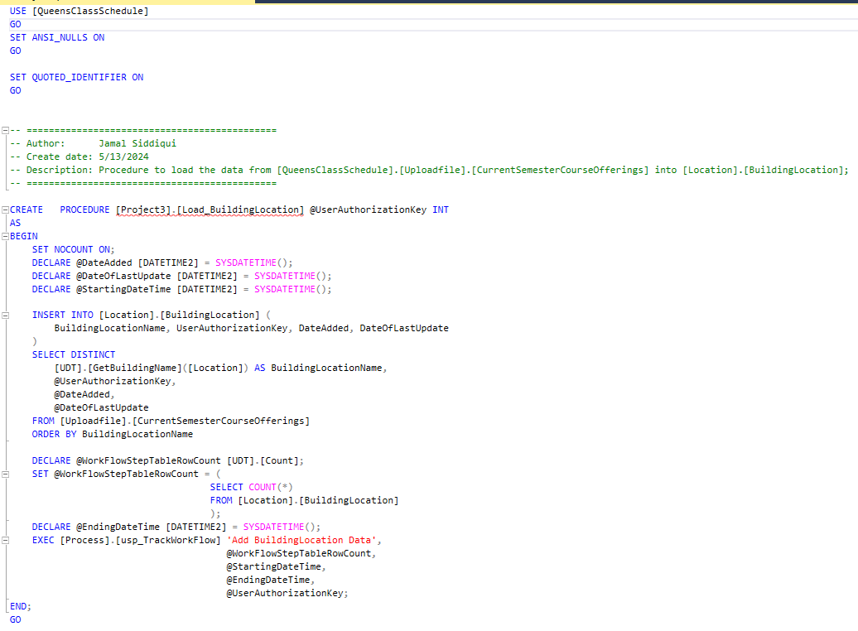
Jamal's Stored Procedure #1

Slide 52
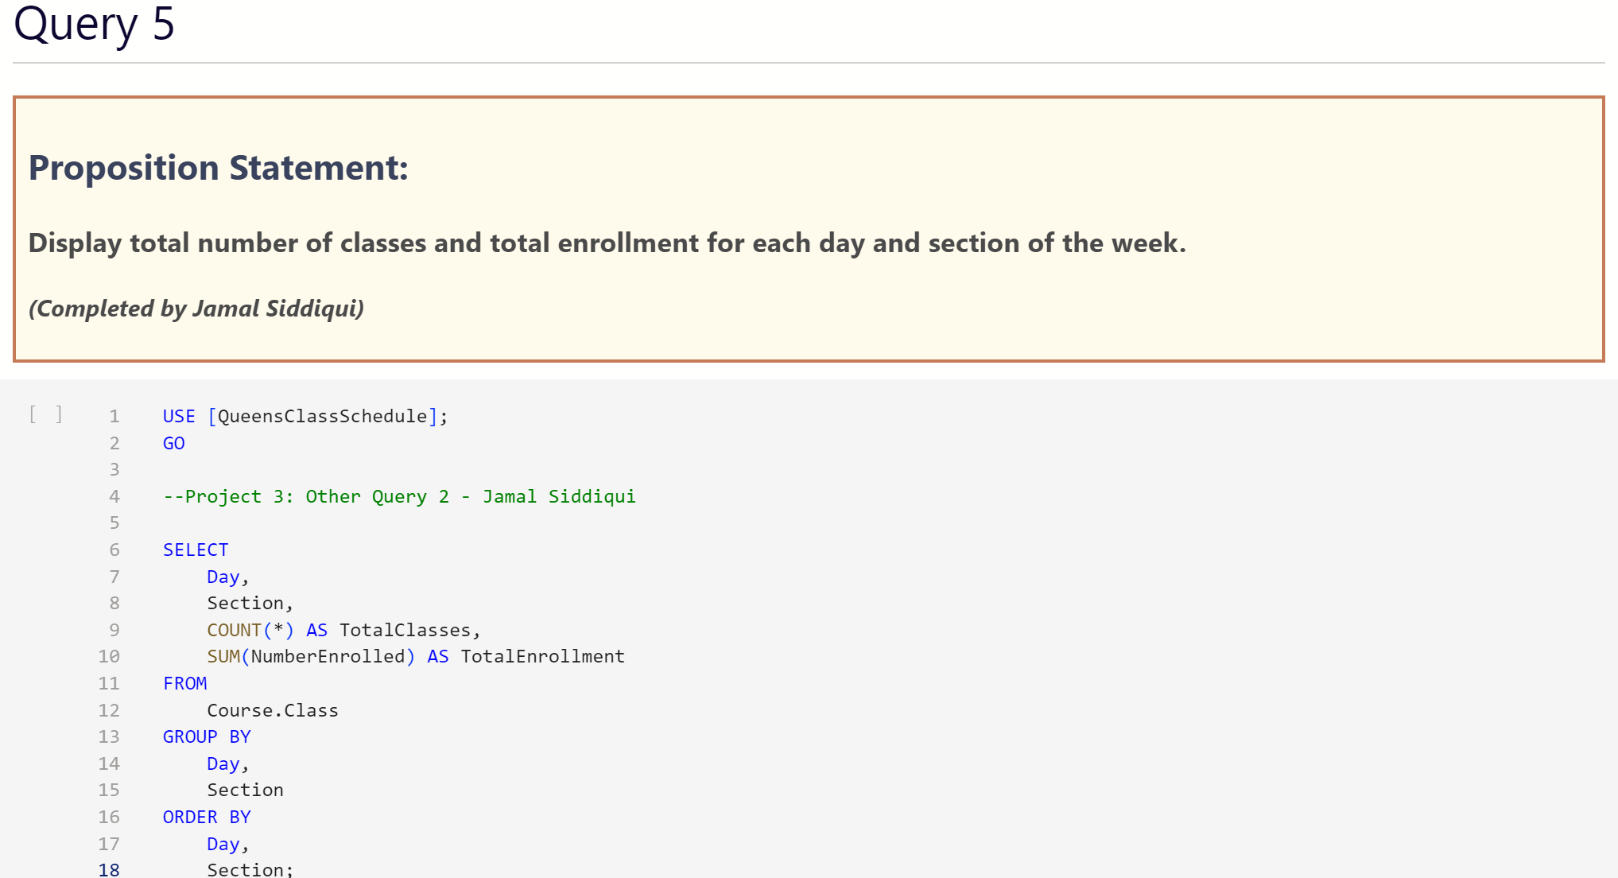
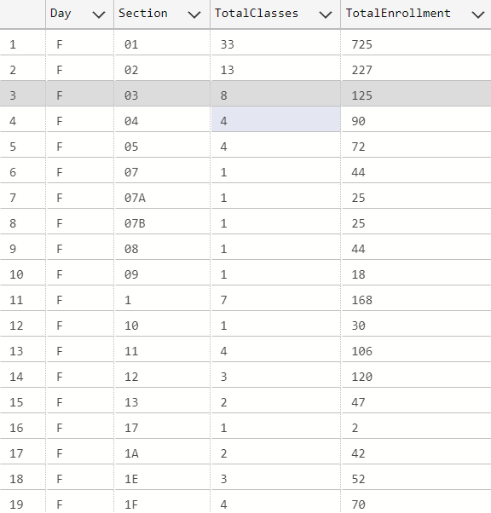
Jamal's Stored Query

Slide 53
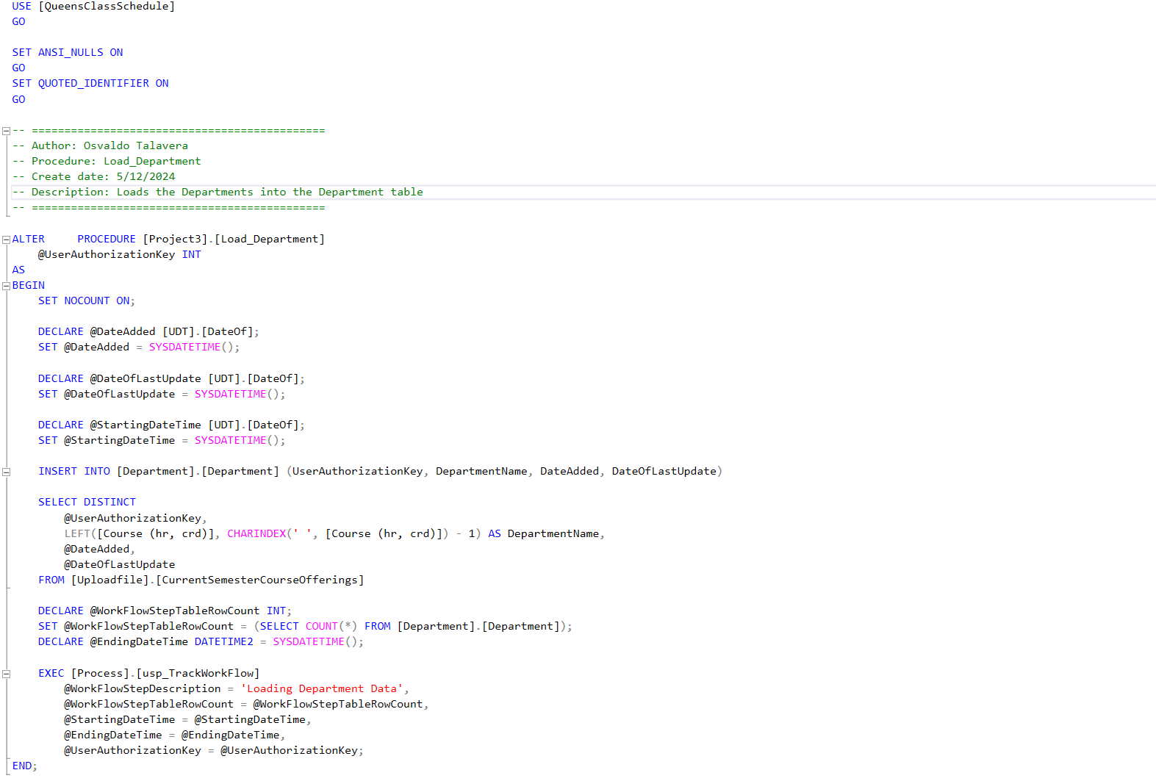
Osvaldo's Stored Procedure #1

Slide 54
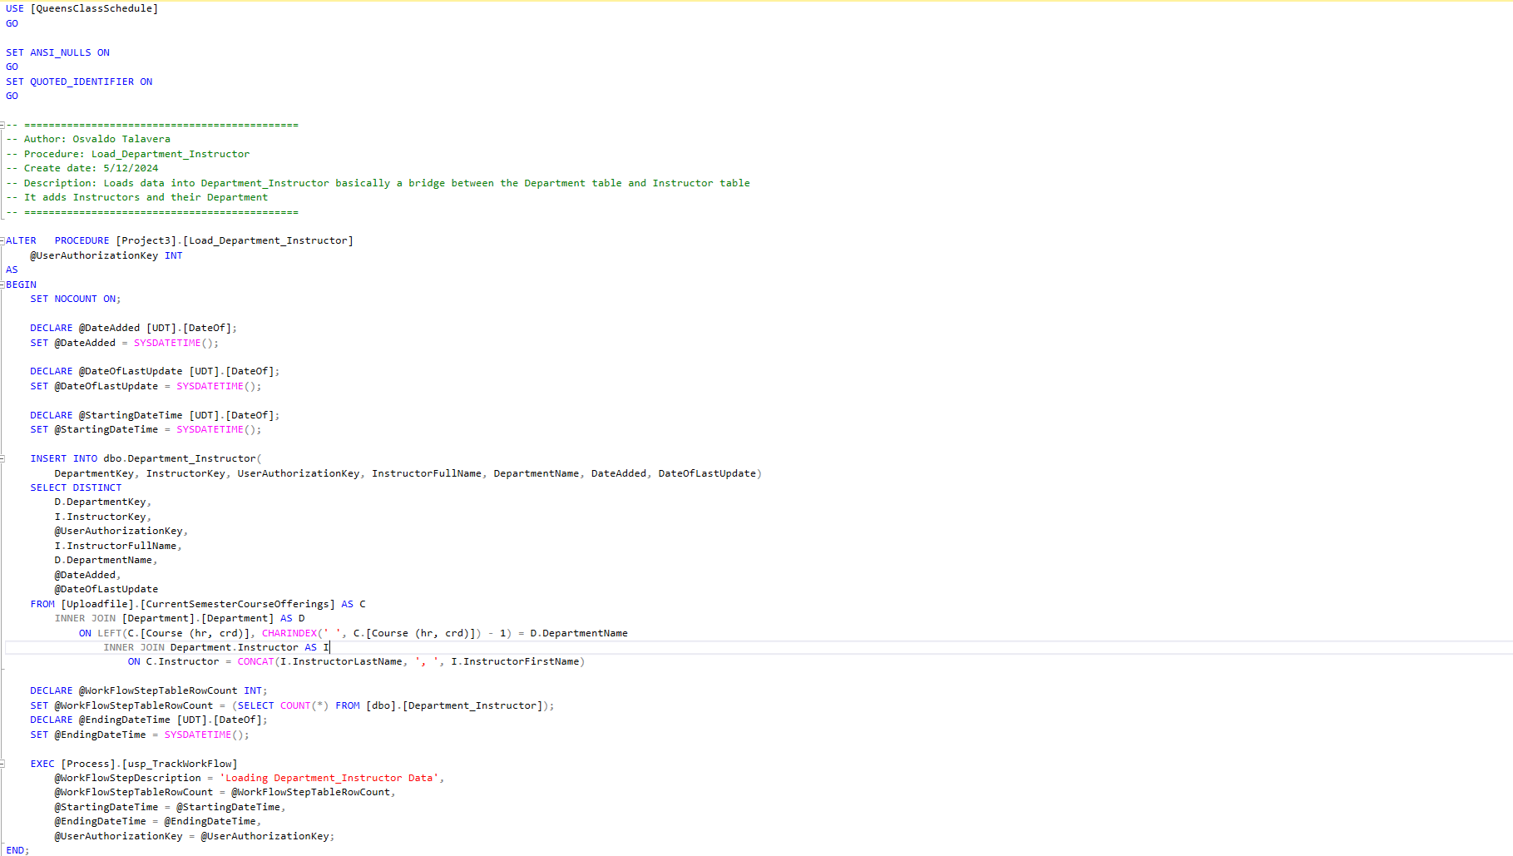
Osvaldo's Stored Procedure #2

Slide 55
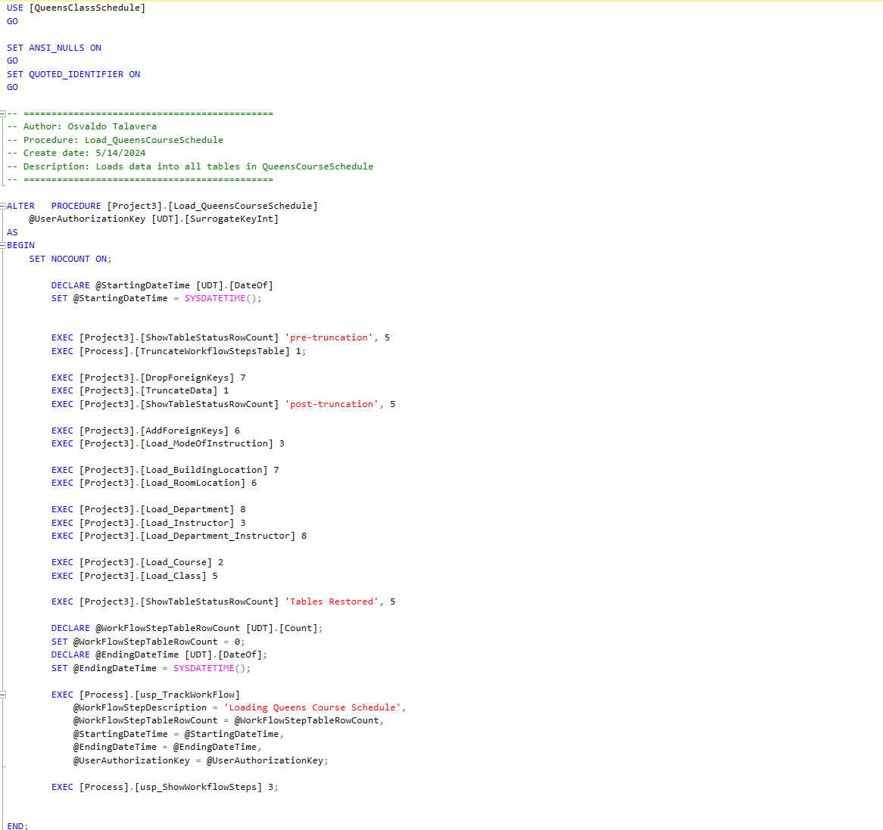
Osvaldo's Stored Procedure #3

Slide 56
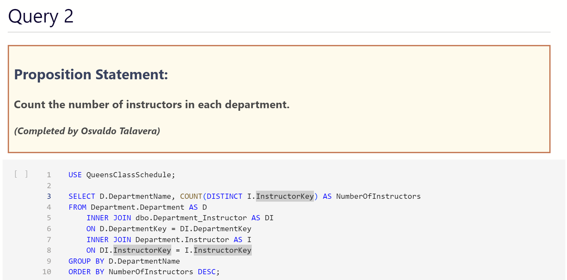
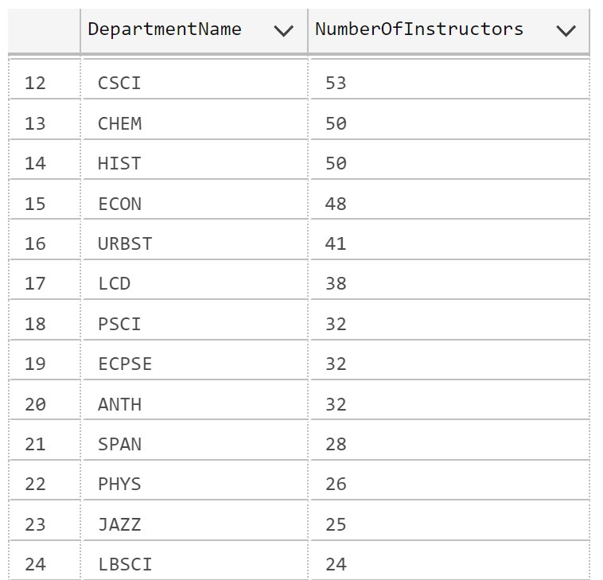
Osvaldo's Stored Query

Slide 57
Database Test Queries (Notebook)

Slide 58
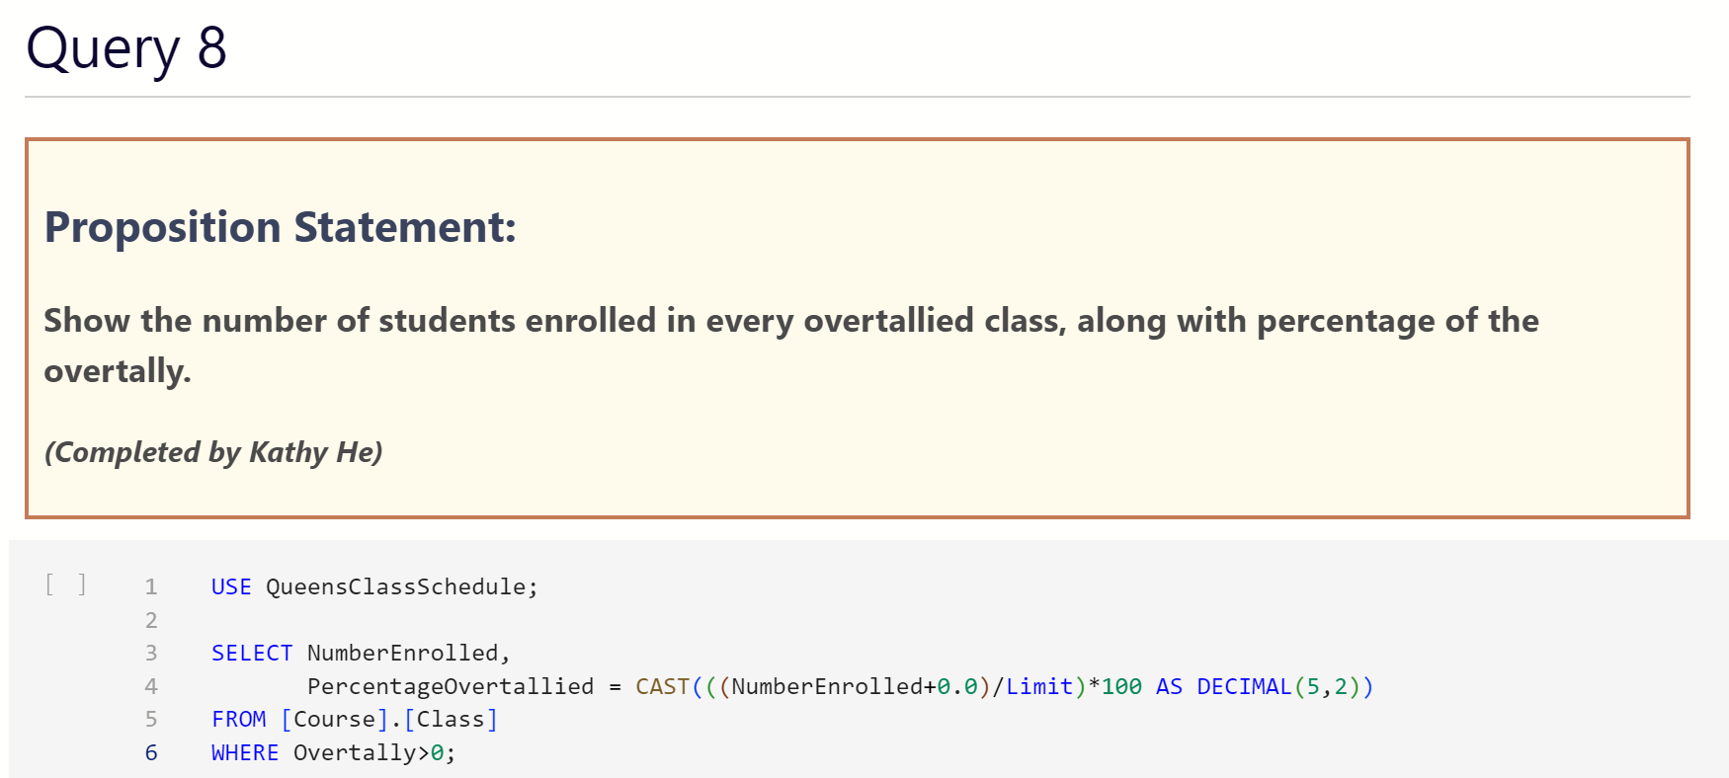
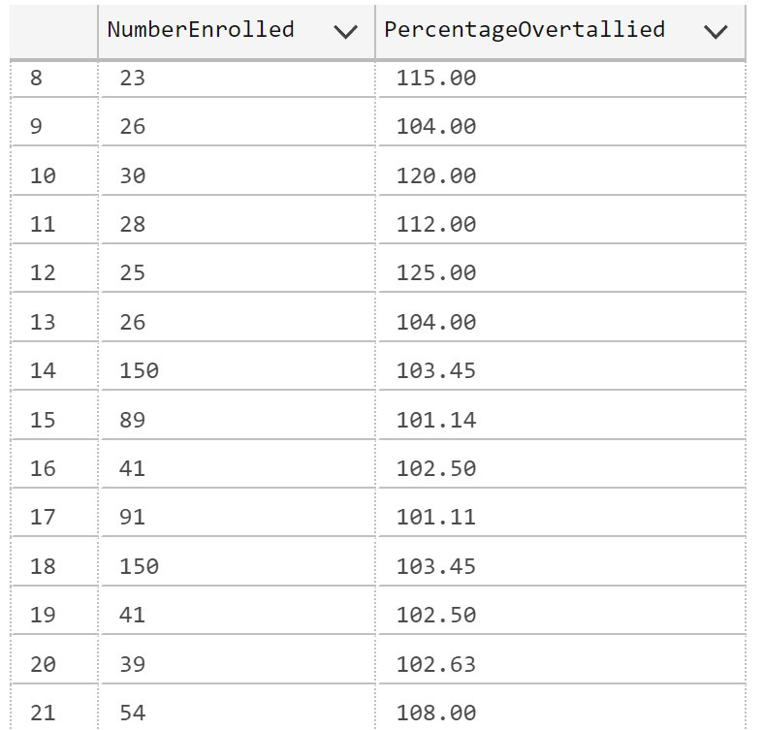

Slide 59
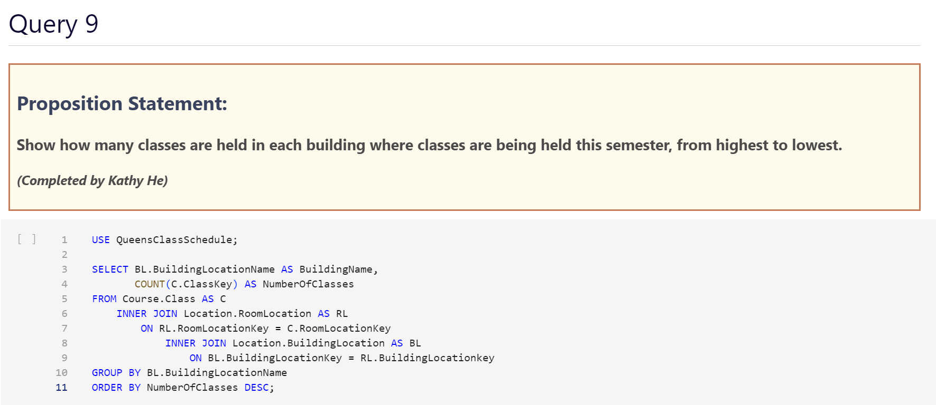
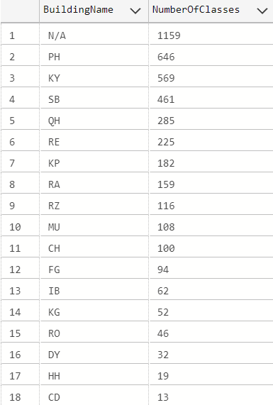

Slide 60
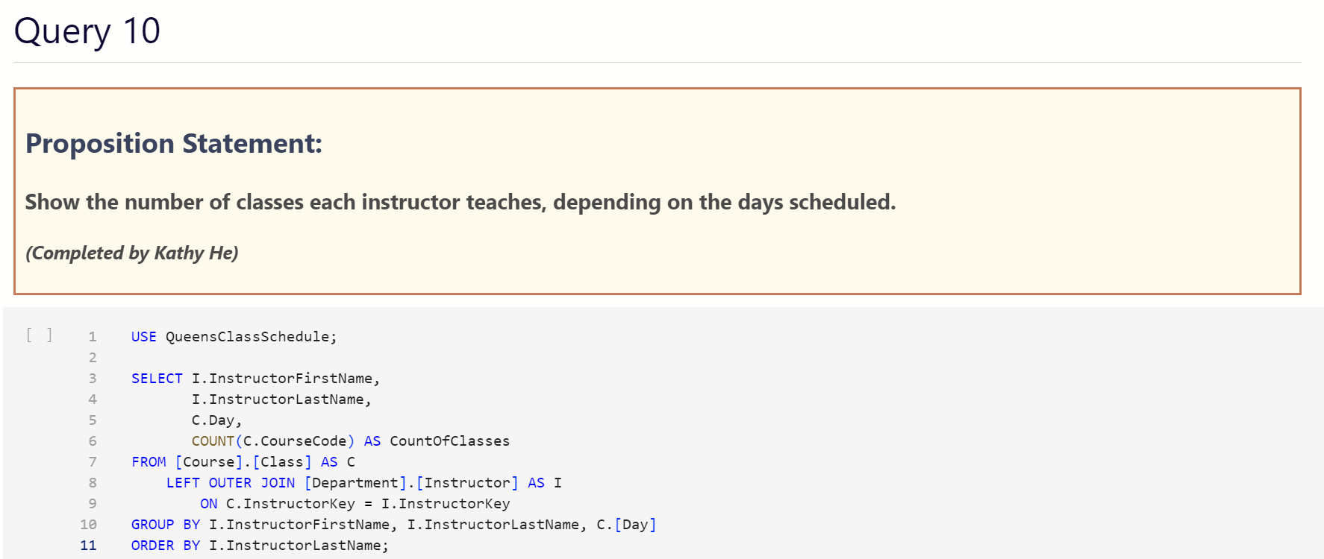


Slide 61



Slide 62



Slide 63



Slide 64
JDBC Execution
Procedures:
Load_QueensCourseSchedule
Process.usp_ShowWorkflowSteps

Slide 65
Database Test Queries (JDBC)

Slide 66
END

